Slide 1
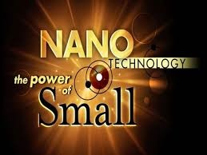

Slide 2
What is Nanotechnology?
The capability to observe, measure, model, and manipulate matter at the length scale between approximately 1 and 100 nanometers, where unusual phenomena permits innovative applications.
“Suddenly, it’s like the periodic table projects out into a new dimension. It’s not just that we have the list of elements, but we can change their sizes and each size is a little bit different than every other when it’s very very small” (Paul Alivisatos)

Slide 4
Matter displays unique physical, chemical, and biological properties at the nanoscale:
It is considerable different from the properties of bulk materials, single atoms, or molecules.
In some cases nanoparticles can be stronger, or have distinct magnetic properties in comparison with other forms or sizes of the exact material.
It can conduct heat or electricity more effectively
It can develop into a more chemically reactive material, or reflect light in a different way, or change color as its size or structure is altered.

Slide 5
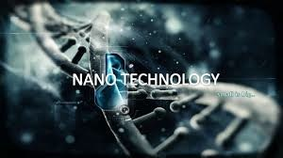
The Drawbacks
Tampering at nanolevel can be devastating for humanity and the environment.

Slide 6
Environmental Impacts of Nanotechnology
One major problem with nanotechnology is its impact on water
Many of these particles can be made water soluble and be absorbed into biological tissues
Which in turn can cause tissue damage
Another harm is that we do not know how to quantify the environmental toxicity of these materials.
Its difficult due to their unique physical and chemical properties.
These particles are very different from their macro counterparts

Slide 7
Some particles change color: for example Nano-gold is red instead of gold.
Nano materials in general appear to behave in ways contrary to our common sense understanding of everyday macro-materials.
Meaning these materials should be classified differently even though they share the same name as their counterparts.

Slide 8
Buckyballs
First discovered in 1985 at the University of Sussex and Rice University
Eventually led to a Nobel Prize for the researchers
Named after American architect Richard Buckminster Fuller, the inventor of the geodesic dome.
In recent years, much research has focused on the potential health and environmental impacts of buckyballs and carbon nanotubes. Fullerenes have been shown to cause brain damage in fish and inhaling carbon nanotubes results in lung damage similar to that caused by asbestos.

Slide 9
Now scientists have found that a certain buckyball configuration can put human skin cells into a sort of suspended animation where they don't die, divide, or grow -- a toxic condition for the human body that might also lead to possible treatments.
Three types of buckyballs were being tested
Tris configuration of buckyballs had three molecular branches coming off the main structural body in one hemisphere
Hexa configuration had six branches arranged in a symmetrical pattern
Plain buckyball.

Slide 10
The cells exposed to the tris buckyballs entered the suspended animation state, which could lead to problems with normal organ development and possibly disease in a living organism. The tris configuration may also interfere with the body's normal immune response against viruses.
"Buckyballs commonly form into clumps that could easily be inhaled by a person as dust particles," Tieleman said. "How they enter cells and cause damage is still poorly understood but our model shows a possible mechanism for how this might occur."

Slide 11
Markets
The possible loss of jobs in the traditional farming and manufacturing industry.
You will also find that the development of nanotechnology can also bring about the crash of certain markets due to the lowering of the value of oil and diamonds due to the possibility of developing alternative sources of energy that are more efficient and won’t require the use of fossil fuels. This can also mean that since people can now develop products at the molecular level, diamonds will also lose its value since it can now be mass produced.

Slide 12
Other consequences…
Atomic weapons can now be more accessible and made to be more powerful and more destructive. These can also become more accessible with nanotechnology.
Since these particles are very small, problems can actually arise from the inhalation of these minute particles, much like the problems a person gets from inhaling minute asbestos particles.
Presently, nanotechnology is very expensive and developing it can cost you a lot of money. It is also pretty difficult to manufacture, which is probably why products made with nanotechnology are more expensive.

Slide 13
Potential risks associated with nanomedicine:
Numerous studies determined that the introduction of fine or coarse particles into the human body by inhalation or other methods can result in higher mortality rates leading to increase in cardio vascular events such as ventricular tachyarrhythmias, cardiac arrhythmias, and myocardial infractions.
Can lead to lung damage and potentially lung cancer.
Increase in plasma viscosity can lead to vital organ damage.

Slide 14
Since nanoparticles will be treated as foreign particles by the human immune system, they will get destroyed in the bloodstream by the cellular process know as phagocytosis, thus proven ineffective.
The use of nano particles in the aerosol form, becoming airborne, potential contamination will extend to other people that are not undergoing any sort of treatment.

Slide 15
More cons…
Lack of financial resources to continue research
Lack of a viable market which would open investment opportunities
Miss-informing the public leads to loose of trust, thus lack of interest in technology
Incomplete research and data - safety of nanotechnology never fully accounted for
Can be devastating to humans and environment
Inadequate regulations associated with nanotechnology
Nanotechnology is not patented

Slide 16
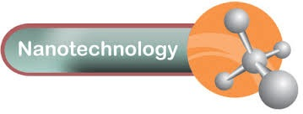
The benefits of
The Dawn of nanobots

Slide 17
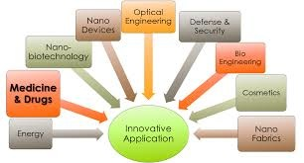

Slide 18
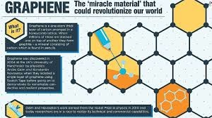

Slide 19
Nanotechnology in everyday life
One of the most useful nanoparticle is Graphene
Graphene is the most conductive material known
Its also the strongest material
Its flexible
Its biodegradable

Slide 20
Graphene can be used as a transistor as well as a display screen
It can be used to deliver electricity more efficiently than any other known material
It can also be used as a battery and as a superconductor allowing flexible batteries and high charge and discharge rate.
It is also the best membrane for reverse osmosis know to man

Slide 21
Nanotechnology in Medicine
Nanoparticles can be used to deliver medicine or even cell protein and enzymes.
Gold nanoparticles are being used to to target cancer cell offering an option of treatment with very little side effect.
Nanoparticles are theorized to be able to take some cell function “artificial blood cells”

Slide 22
Nanotechnology Is beneficial to humanity
Nanotechnology can extend human life and enchant human abilities
It can increase efficiently in medicine, manufacturing and energy transport
it can improve computing and processing power.
Since most nanoparticles are carbon based a lot of them are biodegradable
Most nanoparticle product are cheap due to abundance and the need for a very small amount

Slide 23
Nanotechnology is beneficial to the environment
Prototipe solar panels:
can be more practical to convert sunlight into electricity
use print-like manufacturing processes
can be devised in flexible rolls
thin-film solar electric panels can be suited for computer cases
“flexible piezoelectric nanowires woven into clothing can generate usable energy on-the-go from light, friction, and/or body heat.”
Nanoparticles help create lightweight and flexible solar cells. (Image courtesy of Nanosys)

Slide 24
More benefits…
With the use of enzymes, nano-bioengineering aims to convert cellulose into ethanol for fuel using wood chips, corn stalks, unfertilized perennial grasses, etc.
The need for affordable, clean drinking water could be attained with the use of Nanotechnology. “Unexpected magnetic interactions between ultrasmall specks of rust, […] can help remove arsenic or carbon tetrachloride from water.”
Nanostructured filters can potentially eliminate virus cells from water.
A deionization method proposed by scientists using nanosized fiber electrodes can help cut down on the cost and energy demand for eliminating salts from water.

Slide 25
What is Ultra-Ever Dry?
http://www.youtube.com/watch?v=i4J6uC22Hwo

Slide 26
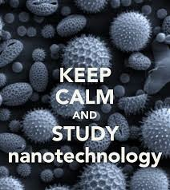
Conclusion
Nanotechnology is a fairly new field of study
It lacks long-term research on the impact on humans and environment
But….
It can completely redefine our use of current technologies
It is organic, and it can prevent global depletion of natural resources
It can provide fast, cost effective detection of impurities to meet the need for clean drinking water
The medicine field would be transformed with the use of nano particles to target the exact problem

Slide 27
Reference
http://www.nano.gov/you/nanotechnology-benefits
http://nanogloss.com/nanotechnology/advantages-and-disadvantages-of-nanotechnology/#axzz31MFuwPyb
http://www.sciencedaily.com/releases/2008/05/080527091910.htm
http://www.waterworld.com/articles/iww/print/volume-8/issue-5/features/nanotechnology-amp-nanoscale-materials-the-good-the-bad-and-the-ugly.html
http://www.waterworld.com/articles/iww/print/volume-8/issue-5/features/nanotechnology-amp-nanoscale-materials-the-good-the-bad-and-the-ugly.html
http://www.scu.edu/ethics/publications/submitted/chen/nanotechnology.html
http://gizmodo.com/5882725/the-miraculous-nasa-breakthrough-that-could-save-millions-of-lives

